Slide 1
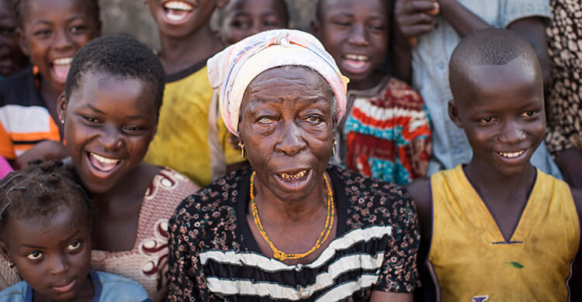
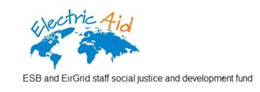

Slide 2

First of all……
Thank you so much for your support
Notes:
Electric Aid has supported Sightsavers since 2012 and from this date have contributed nearly €54,000 in this time
From Motorbikes in Mozambique to support outreach clinics, to TT Surgical Kits in Ghana each grant has brought us a few steps closer towards eliminating avoidable blindness.

Slide 3
Why Sightsavers?
Notes:
Which brings me nicely into Sightsavers and what we do as an organisation… if you oblige me with showing you a clip that captures the essence of what we are trying to achieve

Slide 4
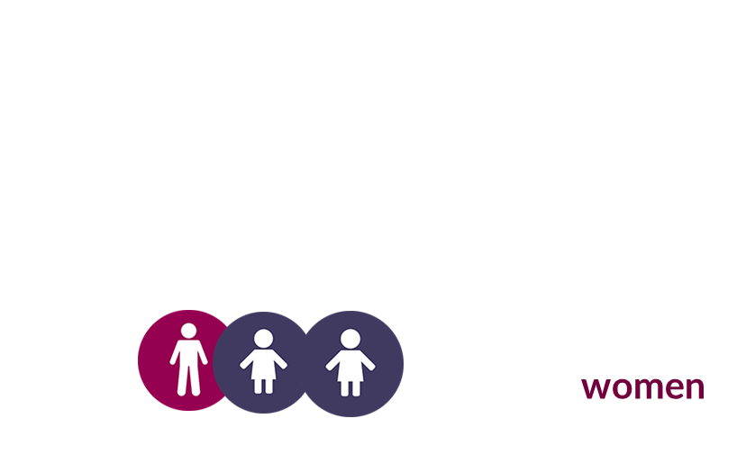

80% of these blinding conditions........
are avoidable.
Notes:
Speak about the challenges here of living with visual impairment
Losing independence
Losing economic power
Losing education
Children staying at home to mind parents/grandparents
90% of children don’t go to school
50% end up neglected and will die

Slide 5

Notes:
Before we go in light of a challenging year for the Irish charity sector
We want to stress the importance of good governance to Sightsavers
December last year we were shortlisted for the good governance awards.
We are very proud of this accreditation and promote it on our website and other social media channels

Slide 6
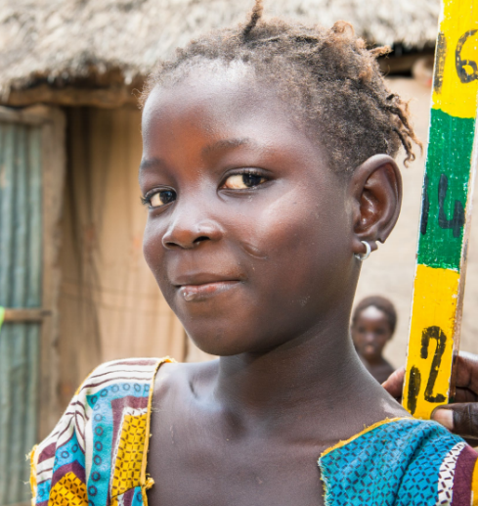
Sightsavers’s Vision
We believe that no-one should be blind from avoidable causes
and that people whose sight cant be saved should live with dignity and independence

Slide 7
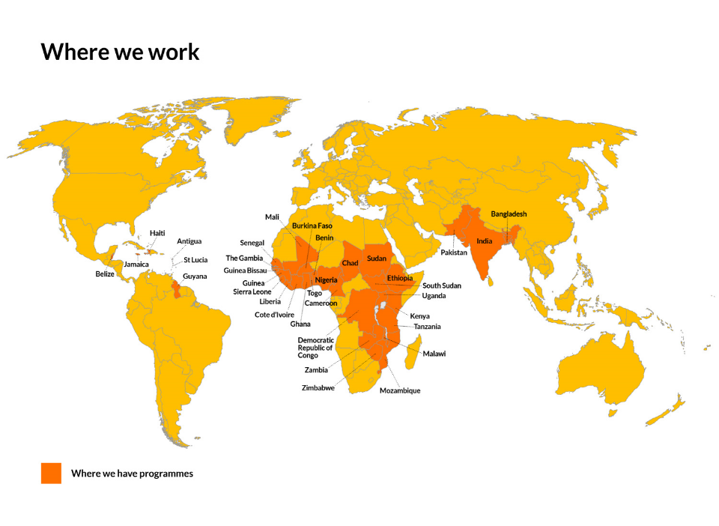
Where we work
Lose
your
independence
Lose
your
economic
power

Slide 8
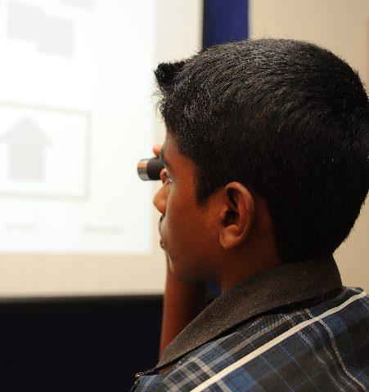




Sri Lanka – the model success story
5,995 professionals supported in training
9,682 cataract surgeries performed
1,726,668 people examined
53,679 pairs of glasses dispensed

Slide 9
Leading Causes of Avoidable Blindness
Cataract
Trachoma
River Blindness
Needlessly Blind

Slide 10

Eliminate Trachoma by 2020
Sightsavers’ Bold Ambition
Eliminate River Blindness by 2025
1 million Cataract Operations by 2018
Notes:
Bold and Ambitious
Hugely Tangible
Hugely Positive…
But also achievable.

Slide 11
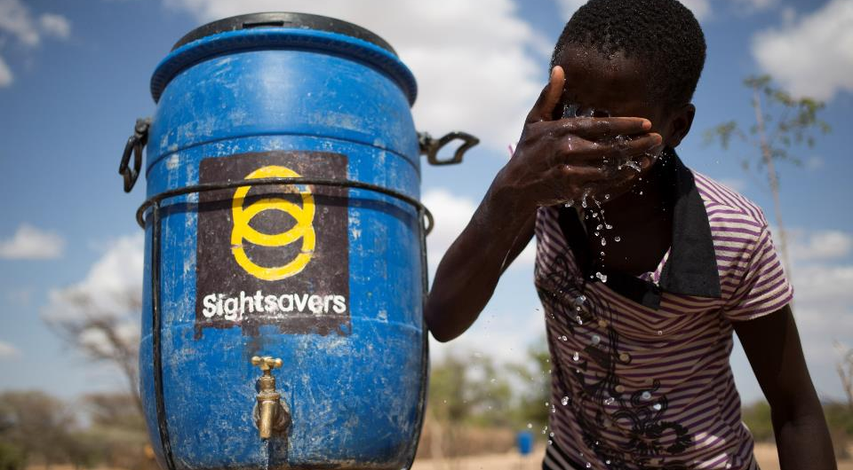
Section Three
Achieving Trachoma Elimination

Slide 12
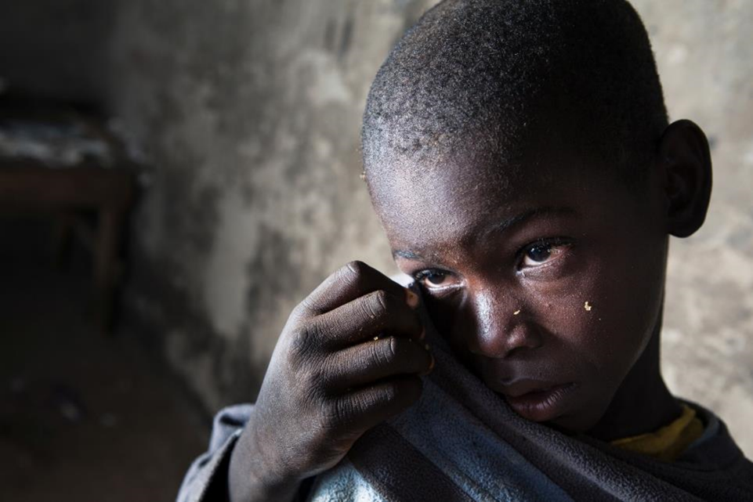

Trachoma
What is Trachoma?
Notes:
What is it?
A disease from the group of Neglected Tropical Diseases
Trachoma – debilitating disease affecting some of the poorest people in the world
It is a bacterial infection spread by flies and between people
Children are repeatedly infected, suffering scaring of the inner eyelid. Gradually turning the eyelid to turn inwards with each blink irreversibly robbing them of their sight.
Over 200 million people live in the areas where Trachoma is endemic.
Putting them at risk of joining the 1.9 million people already blinded or visually impaired from this disease.

Slide 13
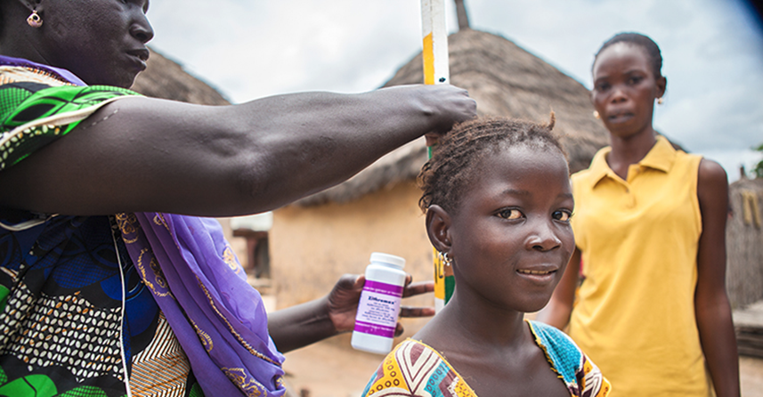
The Affects
Notes:
Affects
Individually
Where Trachoma is endemic it is common among pre-school aged Children so a primary affect it stop children from attending school, and adults from working
After years of repeated infection, and excruciating pain, people develop trachomatous trichaisis and end up going irreversibly blind, (usually this occurs by the age of 30-40)
This obviously leads to a worsening of life experience amongst the poorest of the poor.
Women are blinded up to 4 times more than men usually because of the closer contact with infected children.
Economically
The economic case for eliminating trachoma is undeniable
Trachoma costs the global economy $8 billion in lost productivity every year.

Slide 14
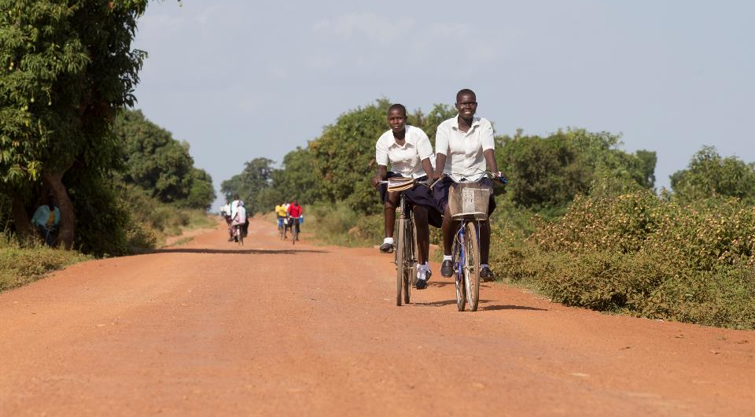
What are Sightsavers doing to beat it?
Notes:
Sightsavers is a leading implementers of the WHO strategy
Together we aim to provide
Surgery for advanced stages
Antibiotics to treat (zithromax) pfizer
Facial Cleanliness
Environmental improvements
Obviously this is intervention is bigger than just one organization so we are part of a international coalition for trachoma control
Working with ministries of health, who provide staff, infrastructure, and coordination with other NGOS, pooling our collective knowledge and playing to each others’ strengths we work to implement the SAFE strategy in the most effective way for each country.
80 million treatments and over 300,000 surgeries to date

Slide 15
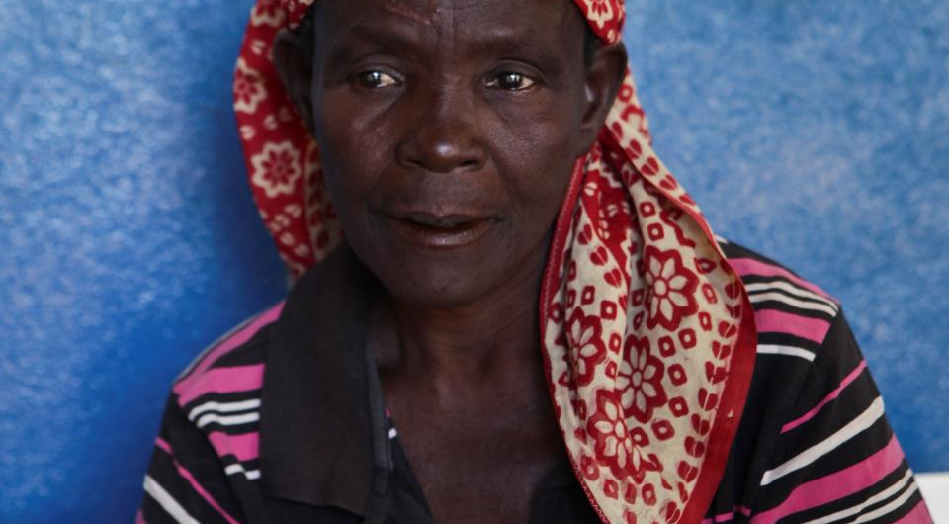
Track Record
Global Trachoma Mapping Project
Notes:
Covered 29 countries largest infectious disease mapping in history.
Three year disease mapping project

Slide 16
This project shown that
100 million people are at risk of blindness from trachoma
1 person was examined every 40 seconds
2,160 people were screened every day
Using smart phone technology we examined 2.6 million people in 1,627 districts
Notes:
This project has been replaced by the Tropical Data Project
Tropical Data uses the same methodologies and technologies, and is designed for the ongoing monitoring of trachoma.

Slide 17
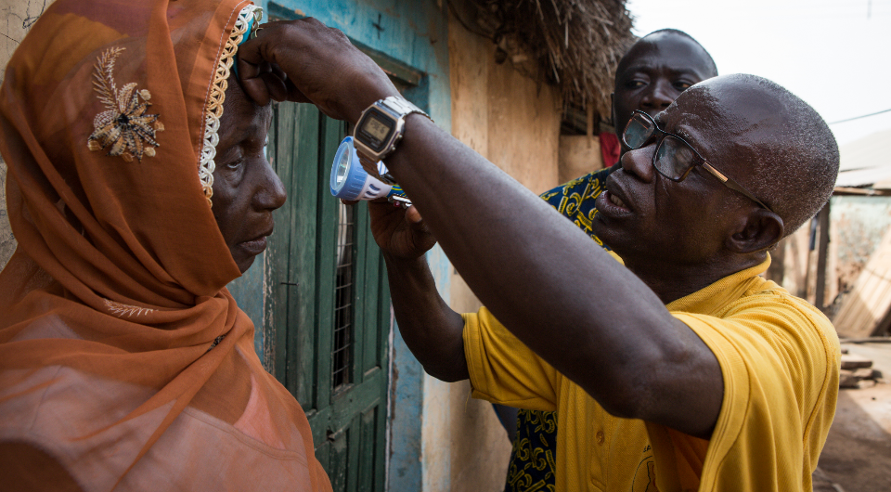
Achieving Elimination Goals
Notes:
Africa remains the most affected continent
As of 1st July, 10 countries had reported achieving elimination goals.
Gambia, Ghana to name just two. And Malawi and Mali also very close to announcing
With most in agreement to accelerate the implementation of the SAFE strategy to achieve their respective elimination targets by 2020

Slide 18
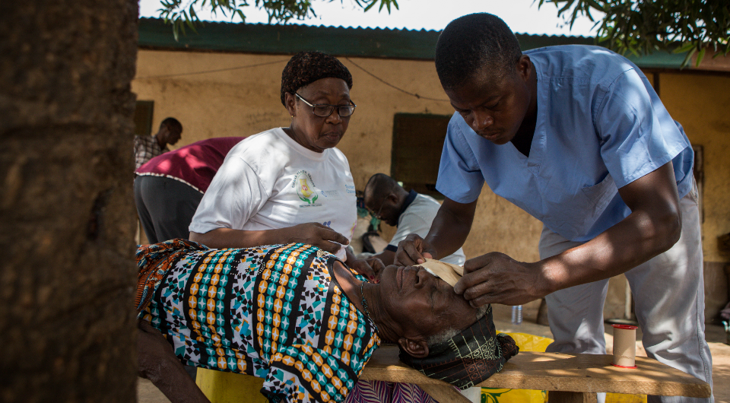
Ghana – an update
Notes:
The aim of this project is to eliminate blinding trachoma from Ghana, this will be achieved by conducting the following activities:
Screening school children and community members
Treating children infected by active trachoma (TF) with Zithromax® every year
Providing surgery for adults found with advance trachoma while strengthening community practices such as environmental and facial cleanliness
Providing training for health workers and non-health workers on trachoma surveillance
Improving access to latrines and potable water
70 cases reported in 2016
Trachoma Elimination Committee established to support the preparation of the dossier to the WHO so that it can be declared as not a public health problem
There is strong capacity there in country to deal with incidental cases of Trachoma For instance 31 ophthalmic nurses were trained in TT surgery in 2016.

Slide 19
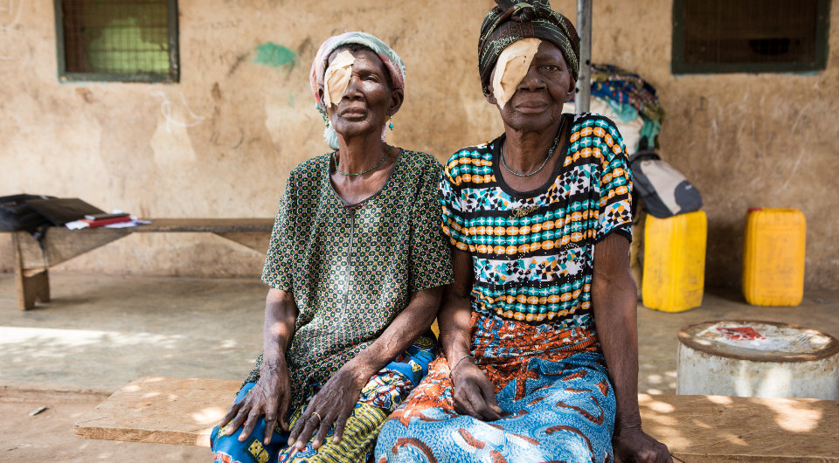
Thank you to everyone involved in Electric Aid for your support

